Slide 1
LOGIC CIRCUITS
Exercise 4

Slide 2
Problem statement
Write a Boolean function of 4 variables given by its table of values, simplify it and draw the logic circuits corresponding to all its simplified forms.

Slide 3
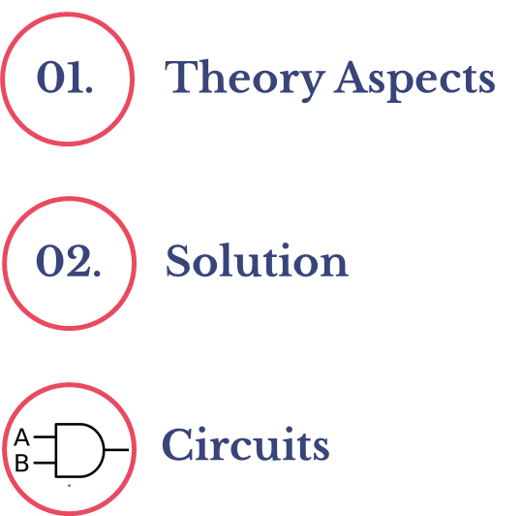

Slide 4
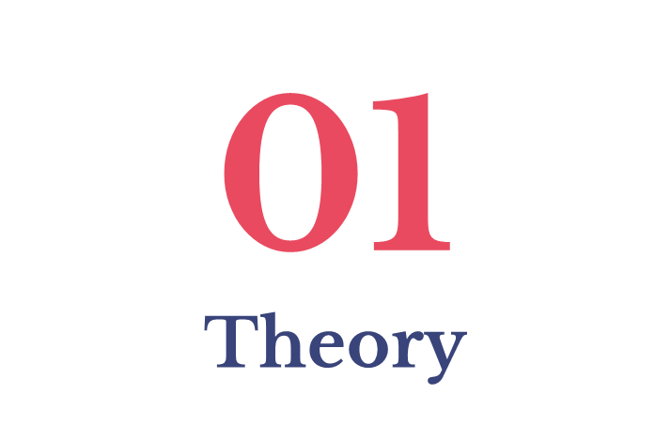

Slide 5
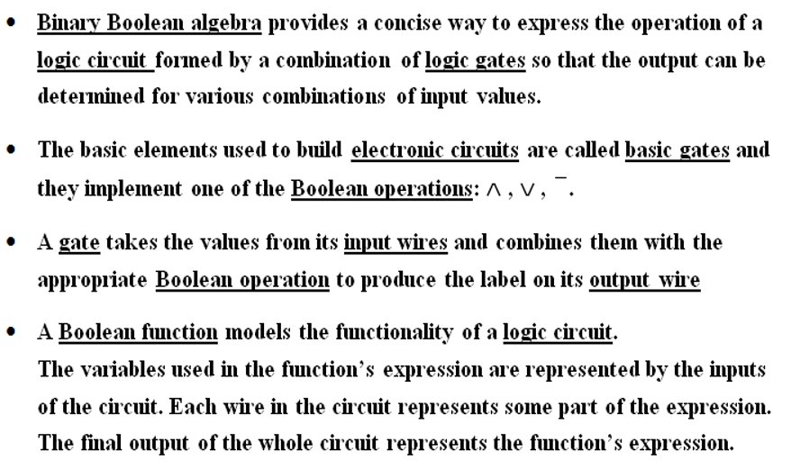

Slide 6
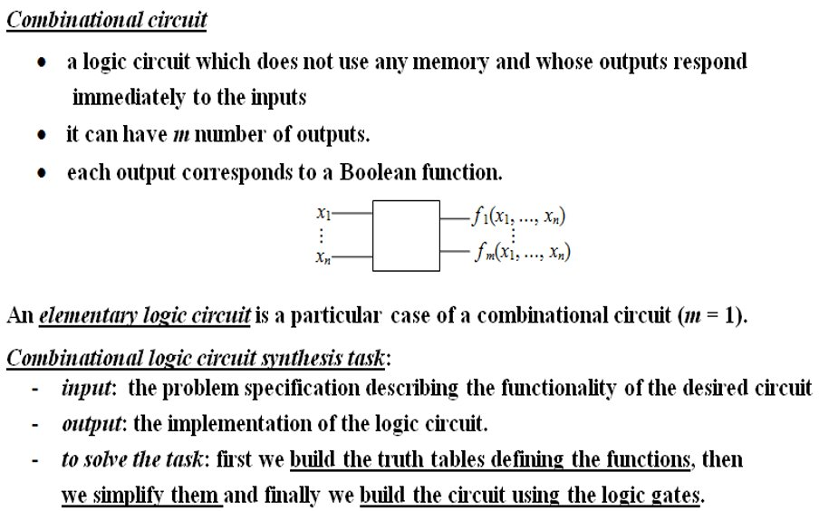

Slide 7
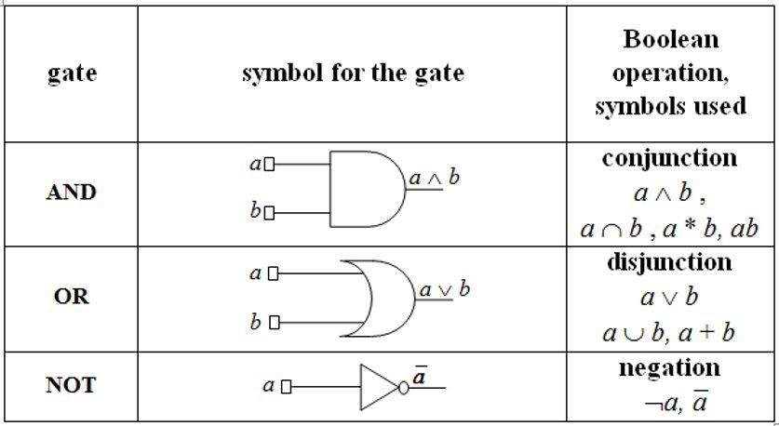
Basic Gates – IEEE Standards

Slide 8
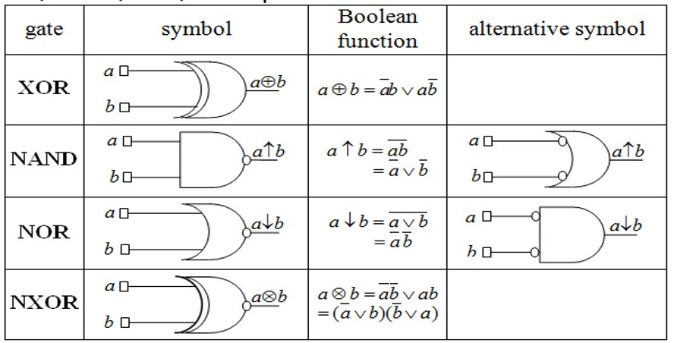
Derived Gates: XOR, NAND, NOR, NXOR

Slide 9
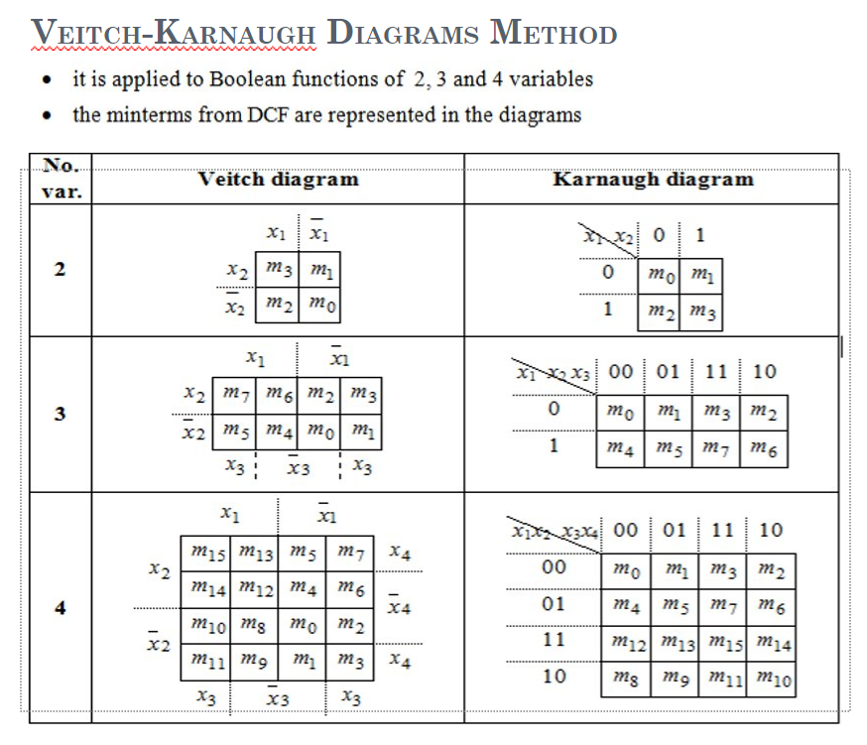

Slide 10
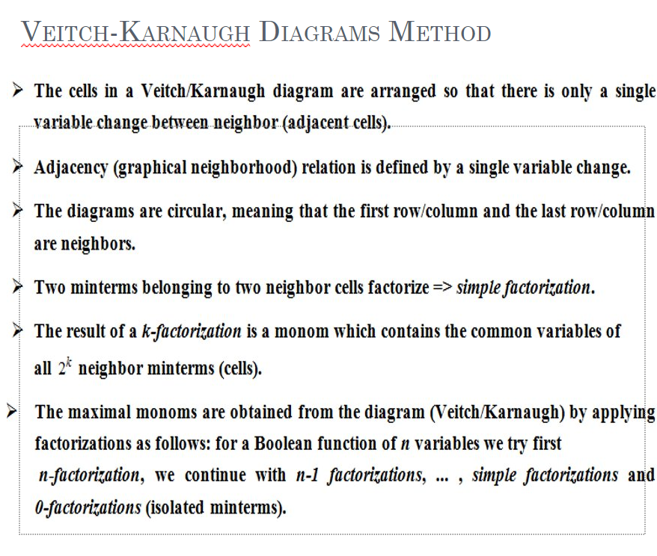

Slide 11


Slide 12
Inputs |  |  |  | Outputs
a | b | c | d | result
0 | 0 | 0 | 0 | 0
0 | 0 | 0 | 1 | 1
0 | 0 | 1 | 0 | 0
0 | 0 | 1 | 1 | 1
0 | 1 | 0 | 0 | 0
0 | 1 | 0 | 1 | 1
0 | 1 | 1 | 0 | 0
0 | 1 | 1 | 1 | 1
1 | 0 | 0 | 0 | 0
1 | 0 | 0 | 1 | 1
1 | 0 | 1 | 0 | 0
1 | 0 | 1 | 1 | 1
1 | 1 | 0 | 0 | 0
1 | 1 | 0 | 1 | 0
1 | 1 | 1 | 0 | 0
1 | 1 | 1 | 1 | 1

Slide 13
The Veitch Diagram
_
a
b | m15 | m13 | m5 | m7 | d
 | m14 | m12 | m4 | m6
 | m10 | m8 | m0 | m2
 | m11 | m9 | m1 | m3 | d
 | c |  |  | c
a
_
d
_
b
_
c
used to simplify the results’ formula into DCF

Slide 14
The Veitch Diagram
_
a
b | 1 |  | 1 | 1 | d
 | 1 | 1 | 1 | 1 | d
 | c |  |  | c
a
_
d
_
b
_
c

Slide 15
I. Double Factorizations
_
a
b | 1 |  | 1 | 1 | d
 | 1 | 1 | 1 | 1 | d
 | c |  |  | c
a
_
d
_
b
_
c
_
max1 = m11 ∨ m9 ∨ m1 ∨ m3 = bd

Slide 16
_
a
b | 1 |  | 1 | 1 | d
 | 1 | 1 | 1 | 1 | d
 | c |  |  | c
a
_
d
_
b
_
c
_
max2 = m5 ∨ m7 ∨ m1 ∨ m3 = ad

Slide 17
II. Simple Factorization
_
a
b | 1 |  | 1 | 1 | d
 | 1 | 1 | 1 | 1 | d
 | c |  |  | c
a
_
d
_
b
_
c
max3 = m15 ∨ m7 = bcd

Slide 18
_
a
b | 1 |  | 1 | 1 | d
 | 1 | 1 | 1 | 1 | d
 | c |  |  | c
a
_
d
_
b
_
c
M(result) = {max1, max2, max3}
C(result) = {max1, max2, max3}
M(result) = C(result) => 1st case of the simplifaction algorithm
_ _
The function result(a,b,c,d) = max1 ∨ max2 ∨ max3 = bd ∨ ad ∨ bcd in a disjunctive simplified form

Slide 19
The Veitch Diagram
b | M15 | M13 | M5 | M7 | d
 | M14 | M12 | M4 | M6
 | M10 | M8 | M0 | M2
 | M11 | M9 | M1 | M3 | d
 | c |  |  | c
used to simplify the results’ formula into CCF this time

Slide 20
The Veitch Diagram
_
a
b |  | 0 |  |  | d
 | 0 | 0 | 0 | 0
 | 0 | 0 | 0 | 0
 |  |  |  |  | d
 | c |  |  | c
a
_
d
_
b
_
c

Slide 21
I. Triple Factorization
_
a
b |  | 0 |  |  | d
 | 0 | 0 | 0 | 0
 | 0 | 0 | 0 | 0
 |  |  |  |  | d
 | c |  |  | c
a
_
d
_
b
_
c
_
max1_d = M14 ∧ M12 ∧ M4 ∧ M6 ∧ M10 ∧ M8 ∧ M0 ∧ M2 = d

Slide 22
II. Simple Factorization
_
a
b |  | 0 |  |  | d
 | 0 | 0 | 0 | 0
 | 0 | 0 | 0 | 0
 |  |  |  |  | d
 | c |  |  | c
a
_
d
_
b
_
c
_
max2_d = M13 ∧ M12 = a ∨ b ∨ c

Slide 23
_
a
b |  | 0 |  |  | d
 | 0 | 0 | 0 | 0
 | 0 | 0 | 0 | 0
 |  |  |  |  | d
 | c |  |  | c
a
_
d
_
b
_
c
M_d(result) = {max1_d, max2_d}
C_d(result) = {max1_d, max2_d}
M_d(result) = C_d(result) => 1st case of the simplifaction algorithm
_ _
The function result(a,b,c,d) = max1_d ∧ max2_d = d ∧ ( a ∨ b ∨ c ) in a conjunctive simplified form

Slide 24
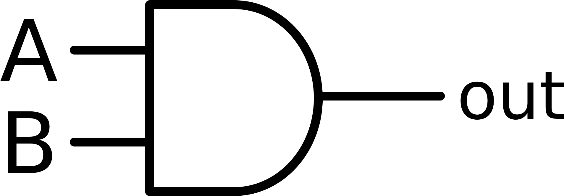
Circuits

Slide 25
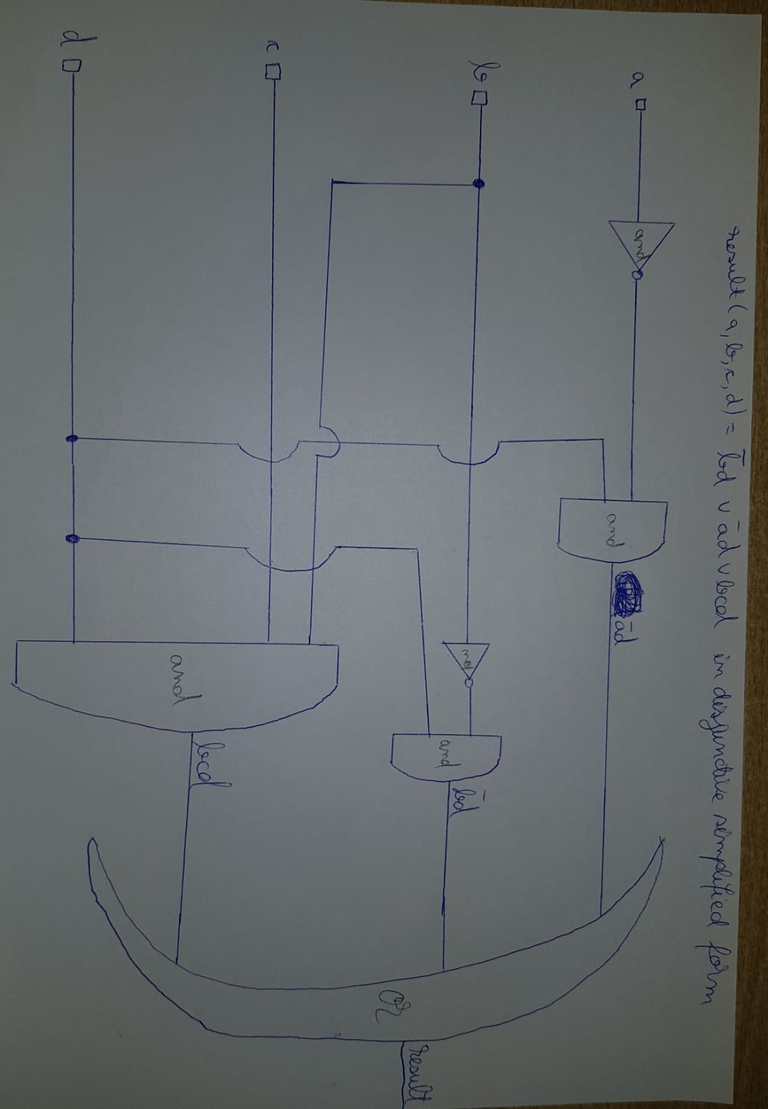
I. Circuit for DCF simplification

Slide 26
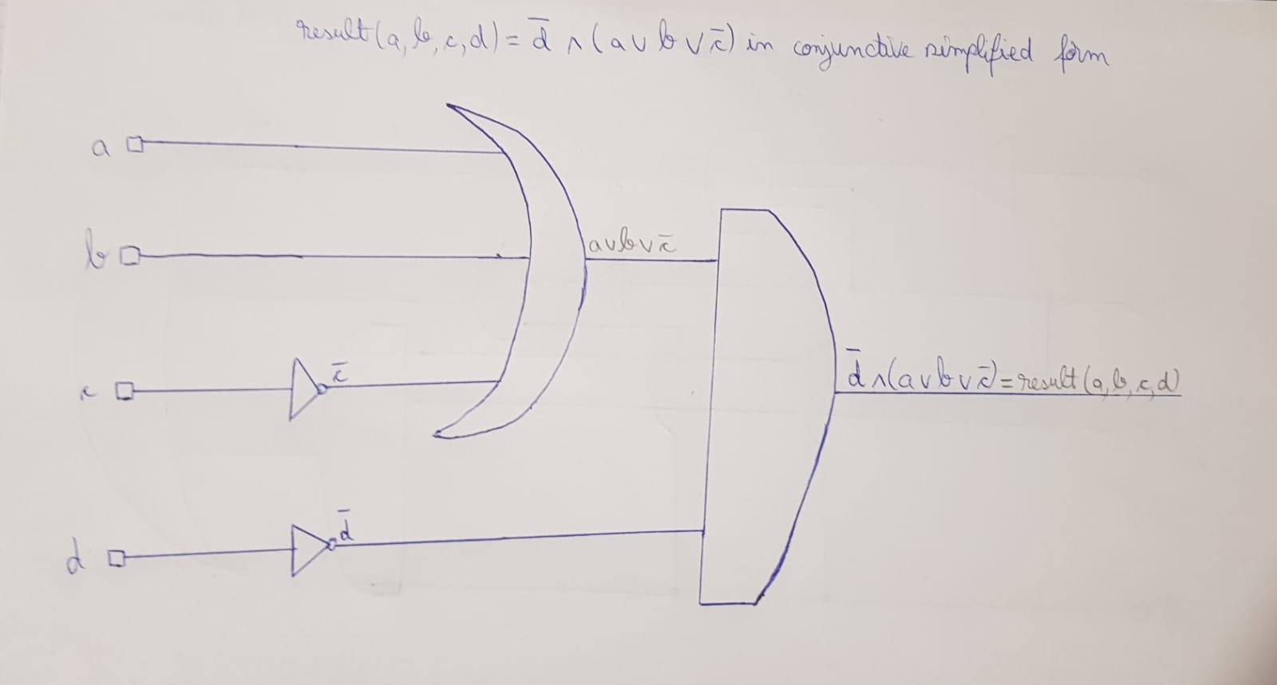
II. Circuit for CCF simplification

Slide 27
Thanks for your attention!
Ask homework to:
Student 1
Student 2
Student 3
Student 4
Student 5

